Slide 1
Trophic interactions, empirical approaches and informing fisheries management part of the PhD comprehensive examination
Sebastian V. Glindtvad,
PhD Student
Centre for Fisheries Ecosystems Research (CFER)

Slide 2

Question: "What are the key empirical approaches (including their advantages and limitations) to characterize trophic interactions in marine ecosystems? Focusing on the Northwest Atlantic: discuss how trophic interactions can be used to inform fisheries management.”
Presentation Structure
Trophic Interactions
Empirical Approaches
Informing Fisheries Management
Discussion
Concluding Remarks
Introduction

Slide 3
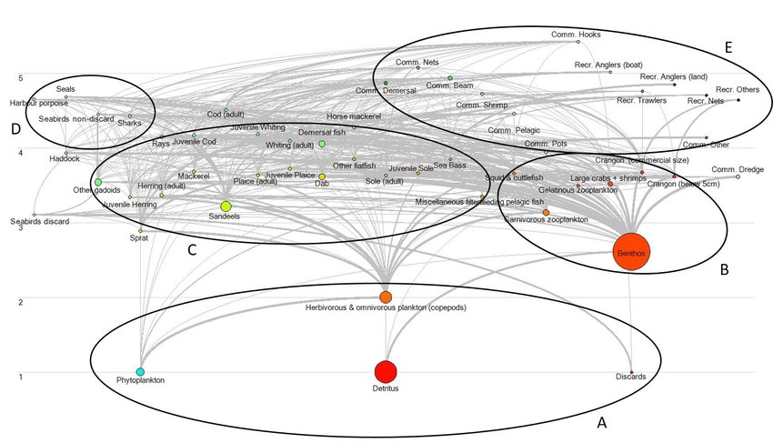
Trophic Interactions
Trophic interactions concerns “the transfer of energy from the bodies of individuals of one species to those of a different species.” ^{[1]}
Connecting species in complex food webs.
Trophic interactions courses reciprocal effects on predator and prey populations. ^{[2]}
Introduction
Ref [1, 2, 10P]
Notes:
https://www.wildanimalinitiative.org/blog/trophicinteractions#:~:text=The%20transfer%20of%20energy%20from,more%20colloquially%2C%20a%20food%20chain.

Slide 4
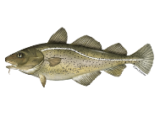
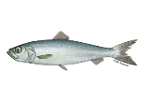

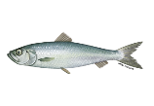
Bottom-up and Top-Down^{[2]}
Abundance
Abundance
Abundance
Abundance
Time
Time
Introduction
Ref [2]

Slide 5
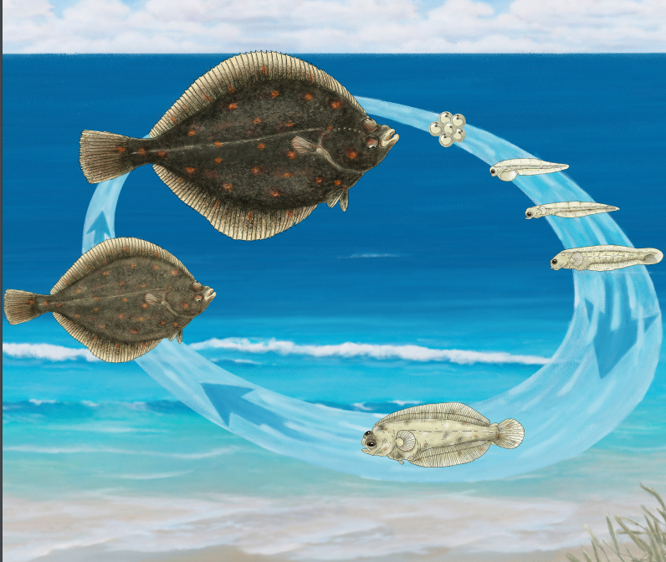
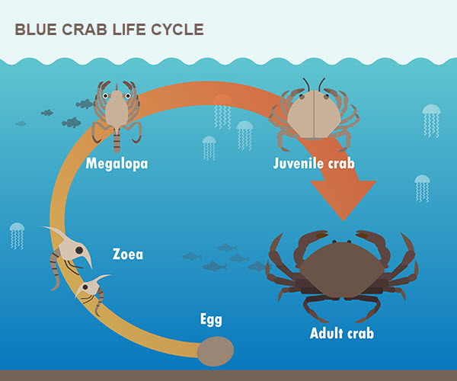
Ontogeny
[1P]
[2P]
Ref [1P, 2P]
Notes:
https://www.aqua.dtu.dk/-/media/institutter/aqua/publikationer/forskningsrapporter_301_351/338-2019-essential-fish-habitats.pdf
https://h5p.org/h5p/embed/477535

Slide 6
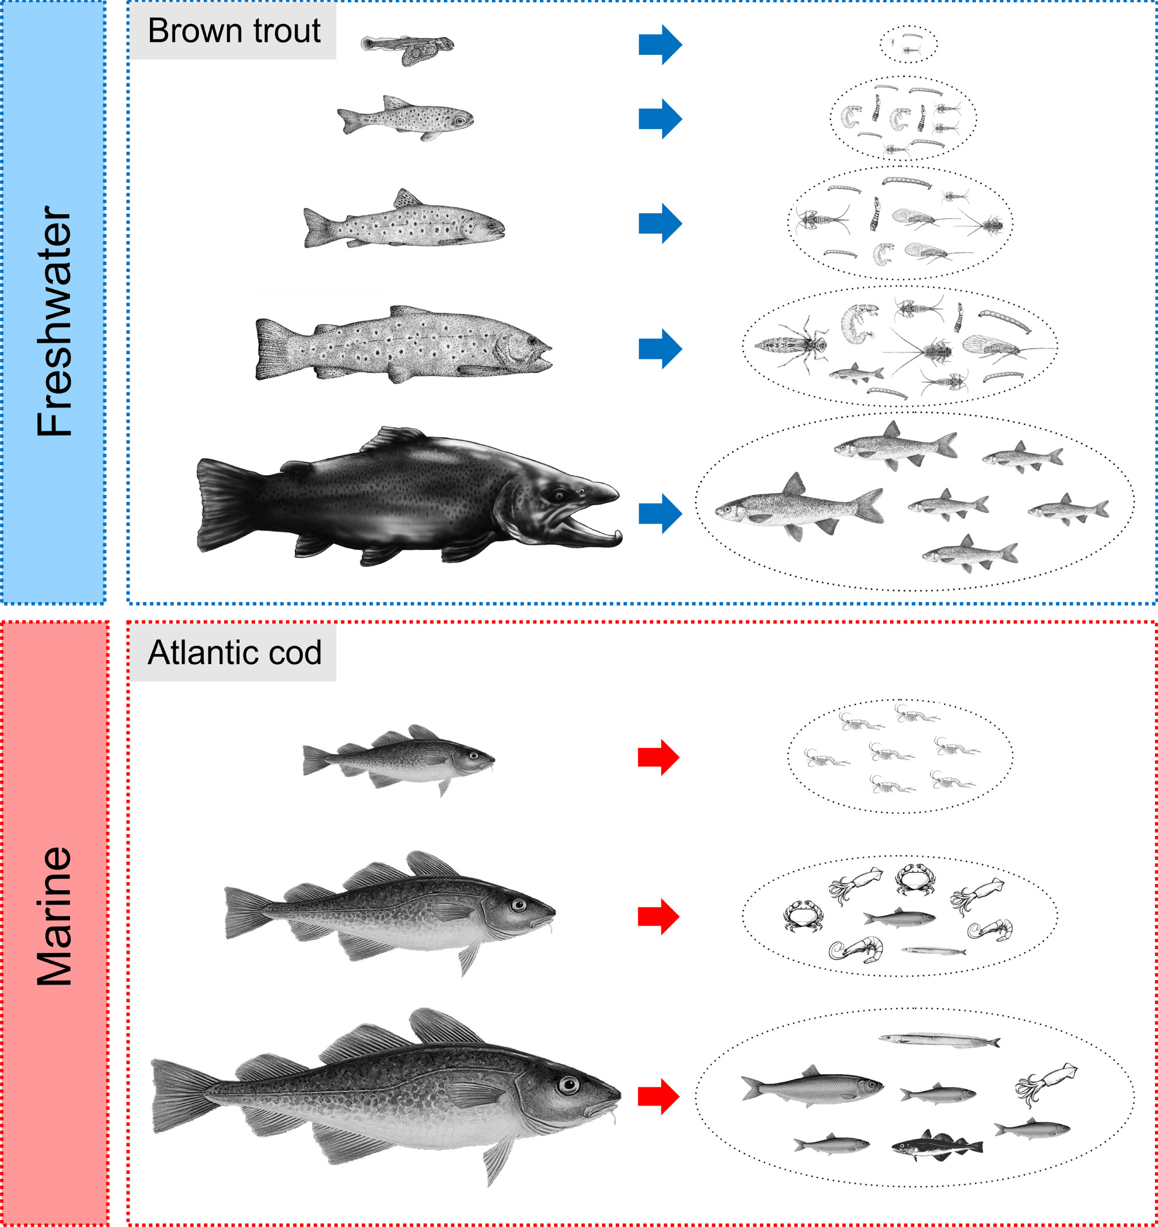


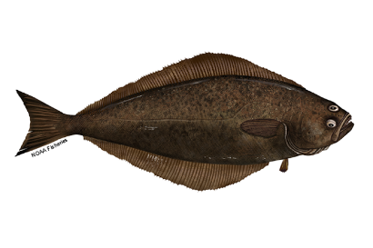
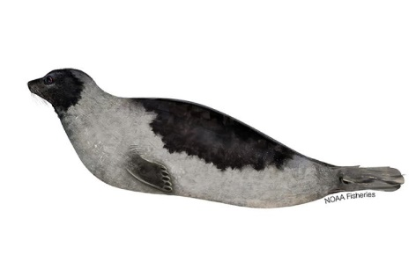
Ontogenetic dietary shifts
Growth
Introduction
Ref [3, 3P]

Slide 7





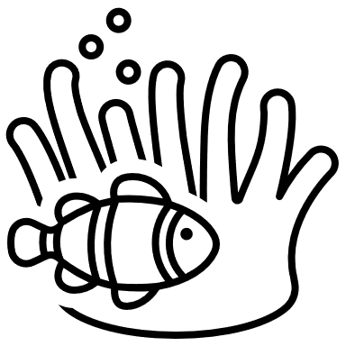
How do we detect trophic interactions
Taxonomic resolution.
Life stage and size of the diet.
Diet on a temporal scale.
Quantification of different prey.
Target species trophic position.
Ingested Material
Stomach content
Genetic analysis of Stomach Content
Assimilated Material
Fatty Acid analysis
Bulk Stable Isotope analysis
Compound Specific Isotope Analysis
Methods
Ref [4]
Notes:
https://linkinghub.elsevier.com/retrieve/pii/S2352249618300223

Slide 8
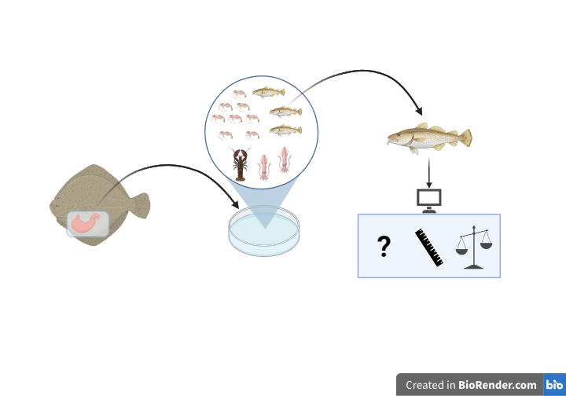





Stomach content analysis (SCA)
High to medium taxonomic resolution.
Provides information on individual preys' life stage and size.
Snapshot of life-time of feeding habits.
Quantify prey as frequency, weight and numerical.
Requires knowledge of prey trophic position.
Methods
Ref [5]

Slide 9
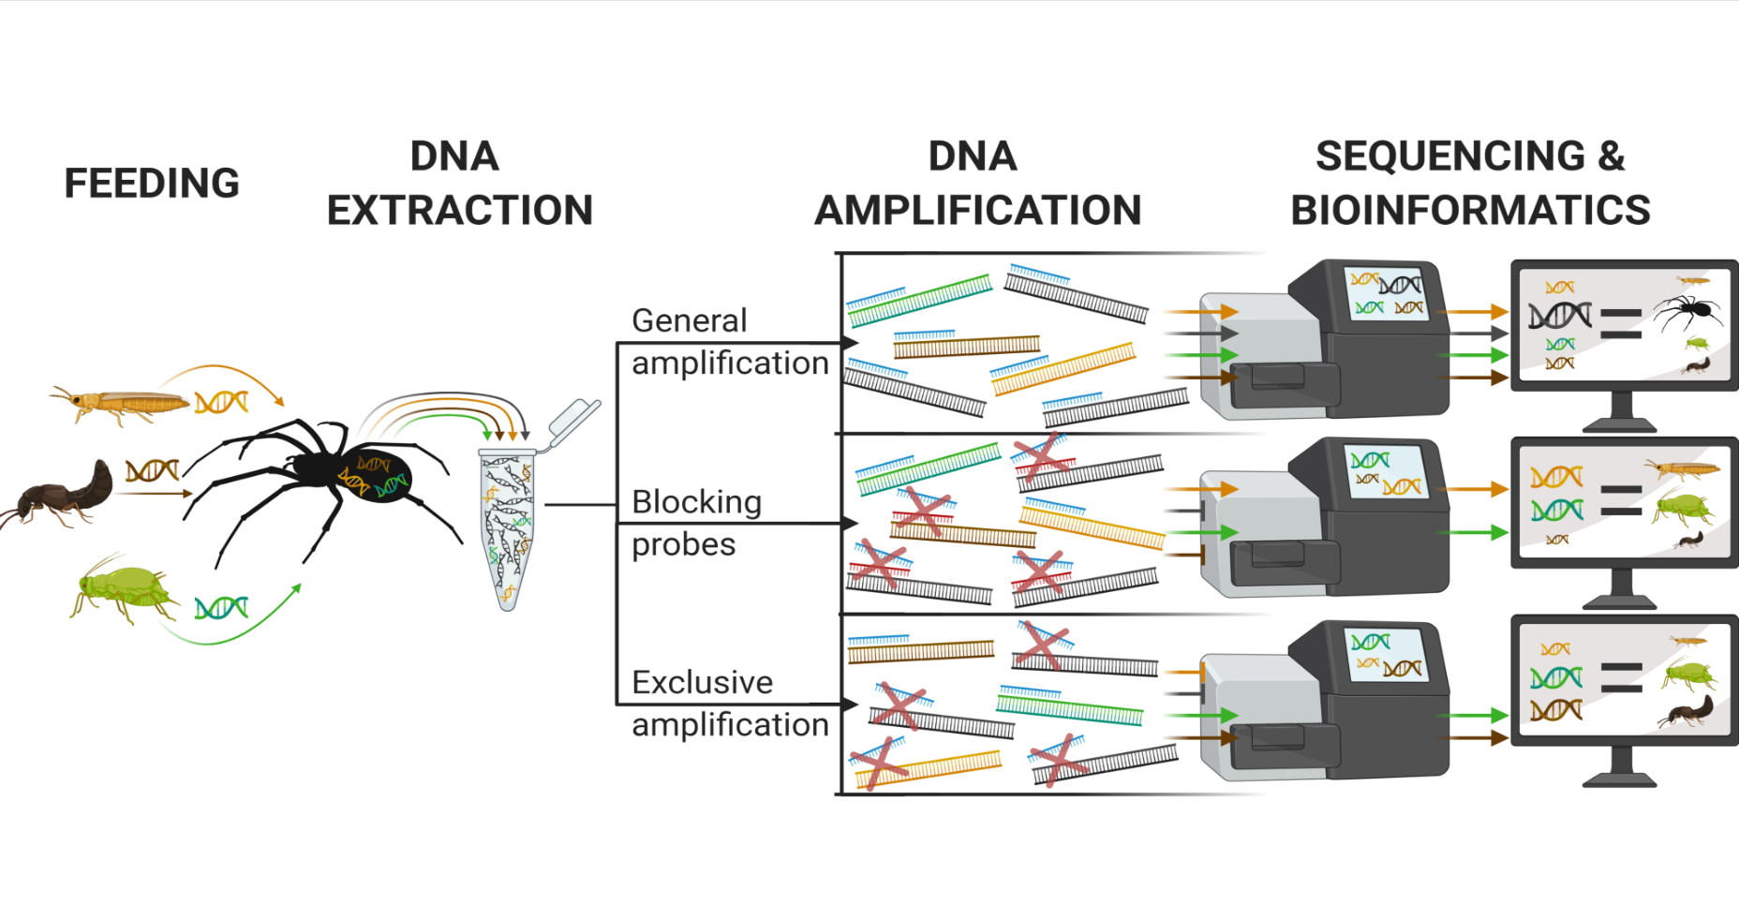
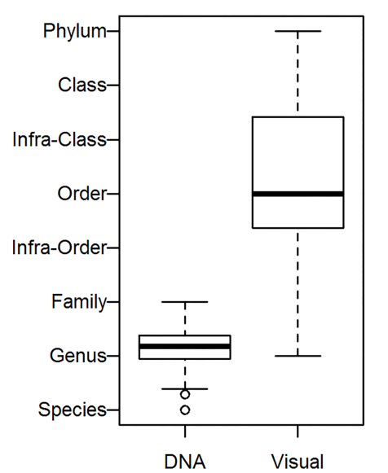


Metabarcoding (mtDNA)
High taxonomic resolution.
Does not provide prey life stage and size information.
Snapshot of life-time of feeding habits.
Absence/presence information.
Requires knowledge of prey trophic position.
biocoenosis
Methods
Ref [6, 7, 4P]
Notes:
de Sousa, L.L., Silva, S.M., and Xavier, R. 2019. DNA metabarcoding in diet studies: Unveiling ecological aspects in aquatic and terrestrial ecosystems. Environmental DNA 1(3): 199–214. Wiley Online Library.
Jakubavičiūtė, E., Bergström, U., Eklöf, J.S., Haenel, Q., and Bourlat, S.J. 2017. DNA metabarcoding reveals diverse diet of the three-spined stickleback in a coastal ecosystem. PLoS One 12(10): e0186929. Public Library of Science San Francisco, CA USA.

Slide 10
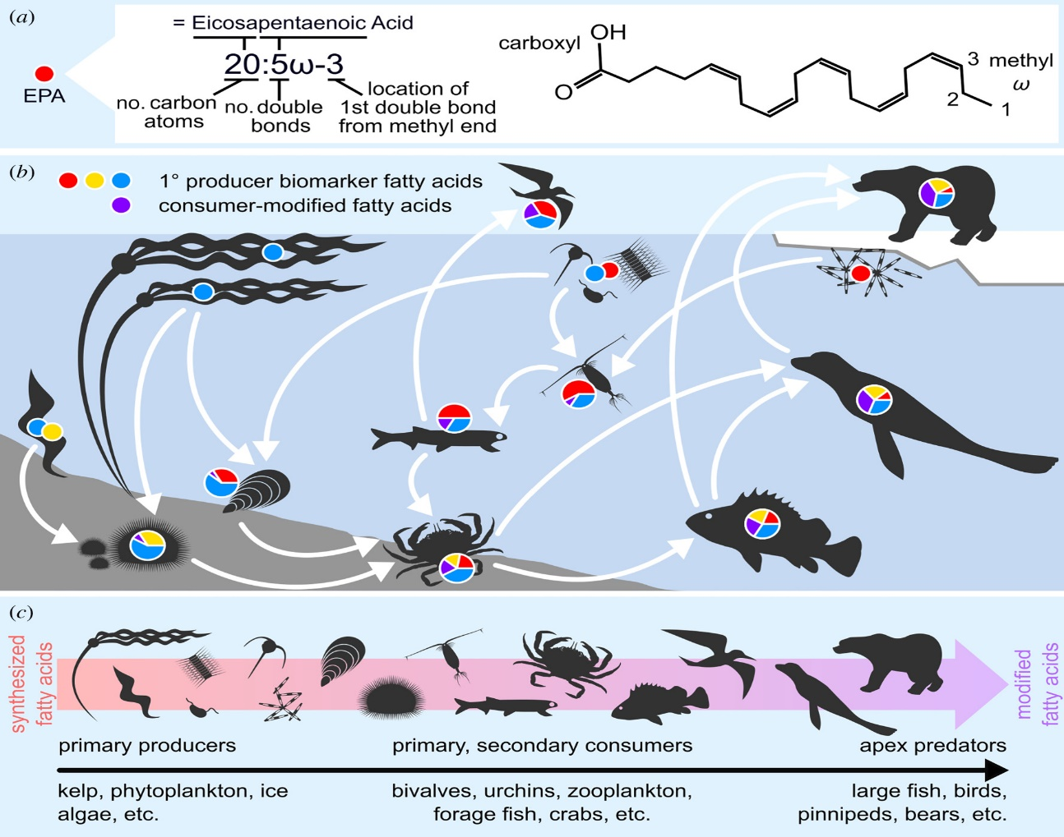




Fatty Acids analysis (FA)
Medium taxonomic resolution.
Does not provide prey life stage and size information.
Days to months, dependent on tissue type.
Proportion of prey consumed using quantitative fatty acid signature analysis (QFASA).
Can provide position estimate.
Methods
Ref [9]
Notes:
Galloway, A.W. and Budge, S.M., 2020. The critical importance of experimentation in biomarker-based trophic ecology. Philosophical Transactions of the Royal Society B, 375(1804), p.20190638.

Slide 11
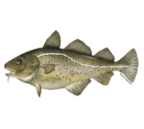

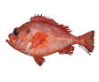

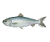
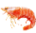

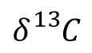

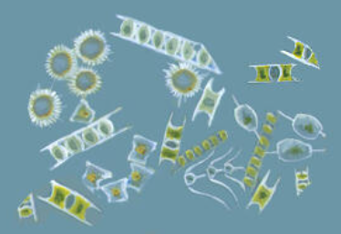

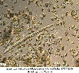


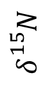
Bulk Stable Isotope analysis (BSIA)
Low taxonomic resolution.
Does not provide prey life stage and size information.
Days, months to years, dependent on tissue type.
Proportion of prey consumed using mixing models.
Good position estimate with baseline.
16
3
13
Trophic level
$$δ{}_{}^{15}N$$
10
2
5
1
Phytoplankton
Makroalge
Microalge
0
-25
-23
-21
-19
-17
-15
$$δ{}_{}^{13}C$$
Methods
Ref [8, 5P]
Notes:
https://www.amnh.org/explore/ology/ology-cards/193-phytoplankton
https://www.sciencedirect.com/science/article/abs/pii/S0048969720330011

Slide 12
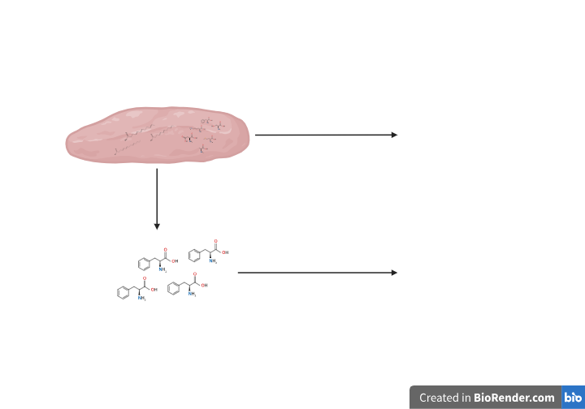
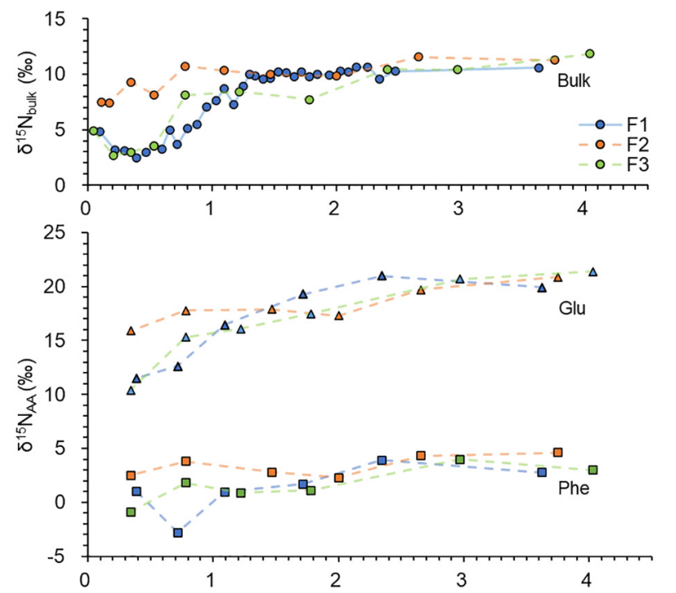
Compound Stable Isotope analysis (CSIA)
Isotope Analysis
Isolation
Isotope Analysis
Methods
Ref [10, 6P]
Notes:
https://www.frontiersin.org/journals/marine-science/articles/10.3389/fmars.2021.796532/full
A Guide to Using Compound-Specific Stable Isotope Analysis to Study the Fates of Molecules in Organisms and Ecosystems (mdpi.com)

Slide 13
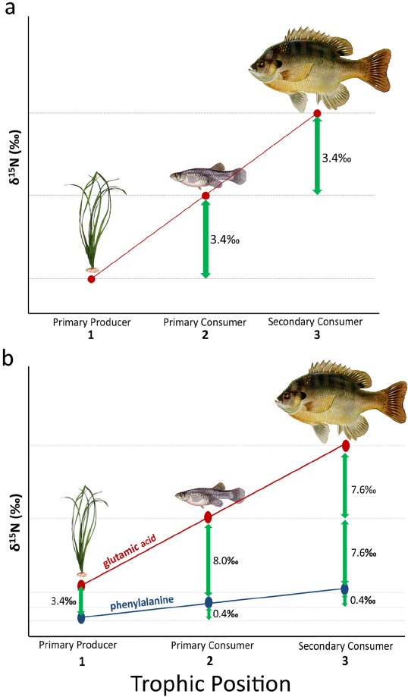
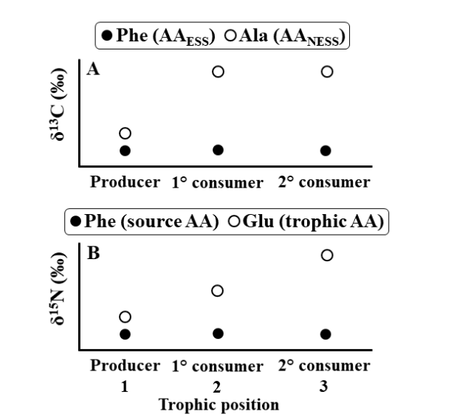
Amino Acid CSIA
Assumed low taxonomic resolution.
Does not provide prey life stage and size information.
Days, months to years, dependent on tissue type.
Assumed similar bulk isotope analysis.
Very good position estimate.
Methods
Ref [11, 12]
Notes:
Whiteman, J.P., Elliott Smith, E.A., Besser, A.C., and Newsome, S.D. 2019. A guide to using compound-specific stable isotope analysis to study the fates of molecules in organisms and ecosystems. Diversity 11(1): 8. MDPI.
Bowes, R.E. and Thorp, J.H., 2015. Consequences of employing amino acid vs. bulk‐tissue, stable isotope analysis: A laboratory trophic position experiment. Ecosphere, 6(1), pp.1-12.
Steffan, S.A., Chikaraishi, Y., Horton, D.R., Ohkouchi, N., Singleton, M.E., Miliczky, E., Hogg, D.B. and Jones, V.P., 2013. Trophic hierarchies illuminated via amino acid isotopic analysis. PloS one, 8(9), p.e76152.

Slide 14
Advantages and limitations
Measured material | Ingestion |  | Assimilation
Techniques | Visual | Genetics | Bulk Stable Isotope | Fatty Acid | Compound Specific Stable Isotopes
Taxonomic Resolution | Medium-High | High | Low | Medium | Unknown
Temporal Scale | Hours to couple of day | Hours to couple of day | Hours-Days-Months-Years | Days-Weeks-Months | Compound specific
Quantification | Frequency, Numbers, Mass | Frequency | Proportion over time. | Proportion over time. | Proportion over time.
Prey Biological information | Yes | No | No | No | No
Trophic position | Yes | Yes | Yes | Yes | Yes
Reference | Taxonomic Library | Genetic Library | Field resource samples, literature | Field resource samples, literature | Field resource samples, literature
Methods
Notes:
Lav en tabel med symboler paa i stedet for tre koloner med skrift.

Slide 15

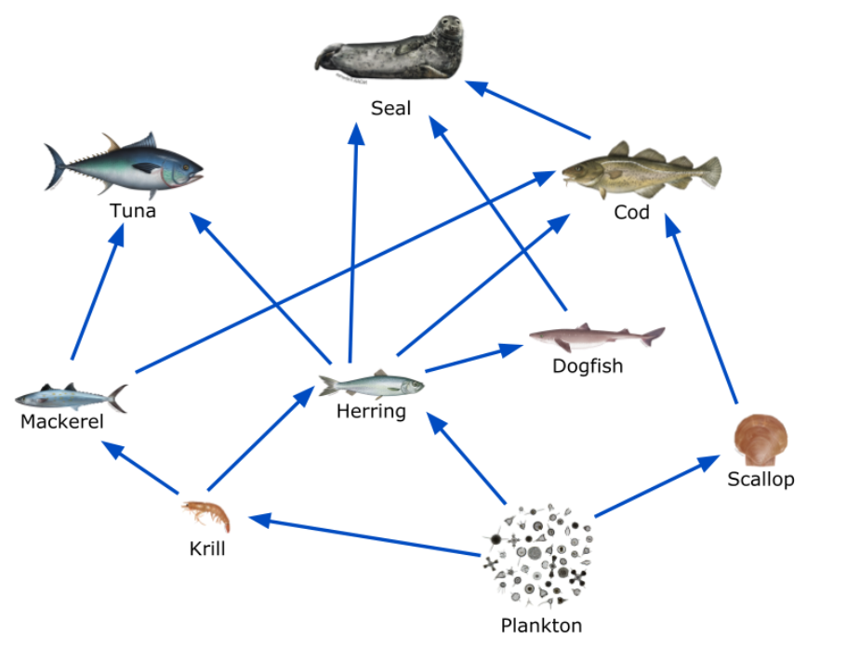
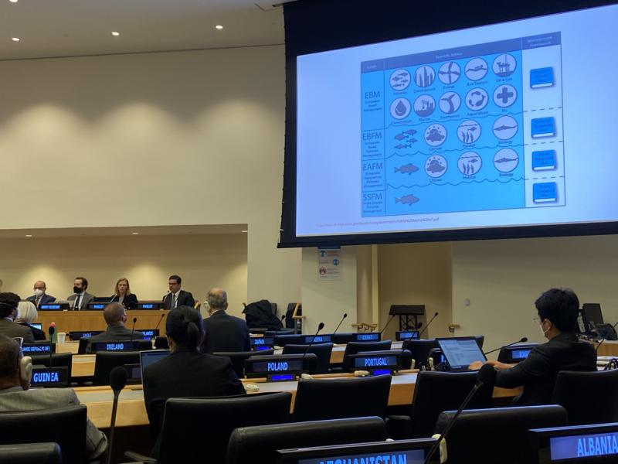
How can such information help?
NOAA
NOAA
Informing FM
Ref [7P, 8P]
Notes:
https://oceanservice.noaa.gov/education/marine-ecosystem-modeling-vr/ocean-food-webs/activity-4.html
https://www.fisheries.noaa.gov/feature-story/noaa-fisheries-leading-united-nations-advancing-ecosystem-approaches-fisheries

Slide 16
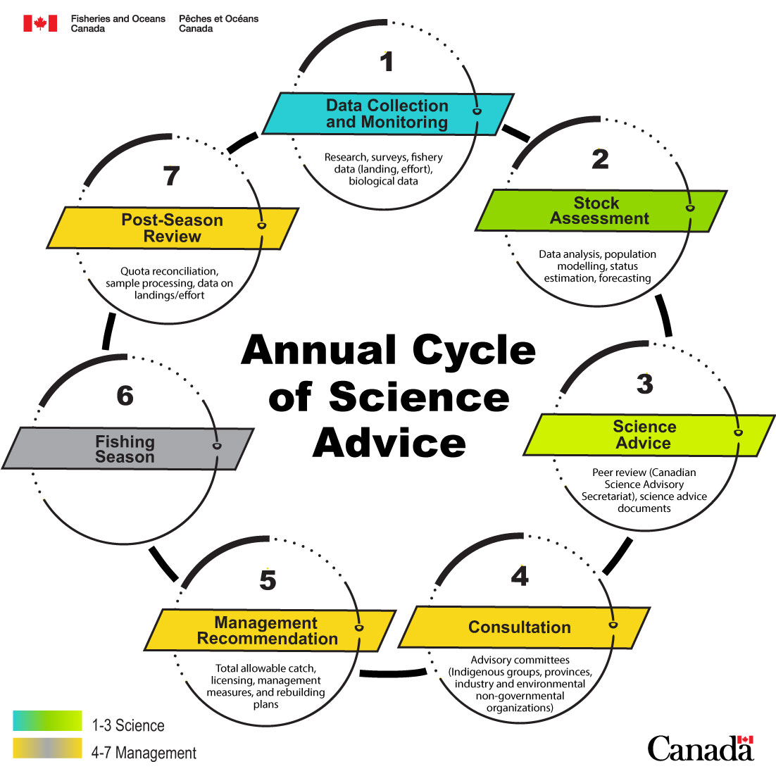
Stock assessment and fisheries management
Stock assessment and Science Advice
Estimate stock status
Healthy, cautious or critical
Forecasting stock productivity into the near future.
Stock response to different management actions.
Advice on recovery plans for collapsed stocks.
Informing FM
Ref [13]
Notes:
https://www.dfo-mpo.gc.ca/science/species-especes/fisheries-halieutiques/advice-conseil/index-eng.html#cycle

Slide 17
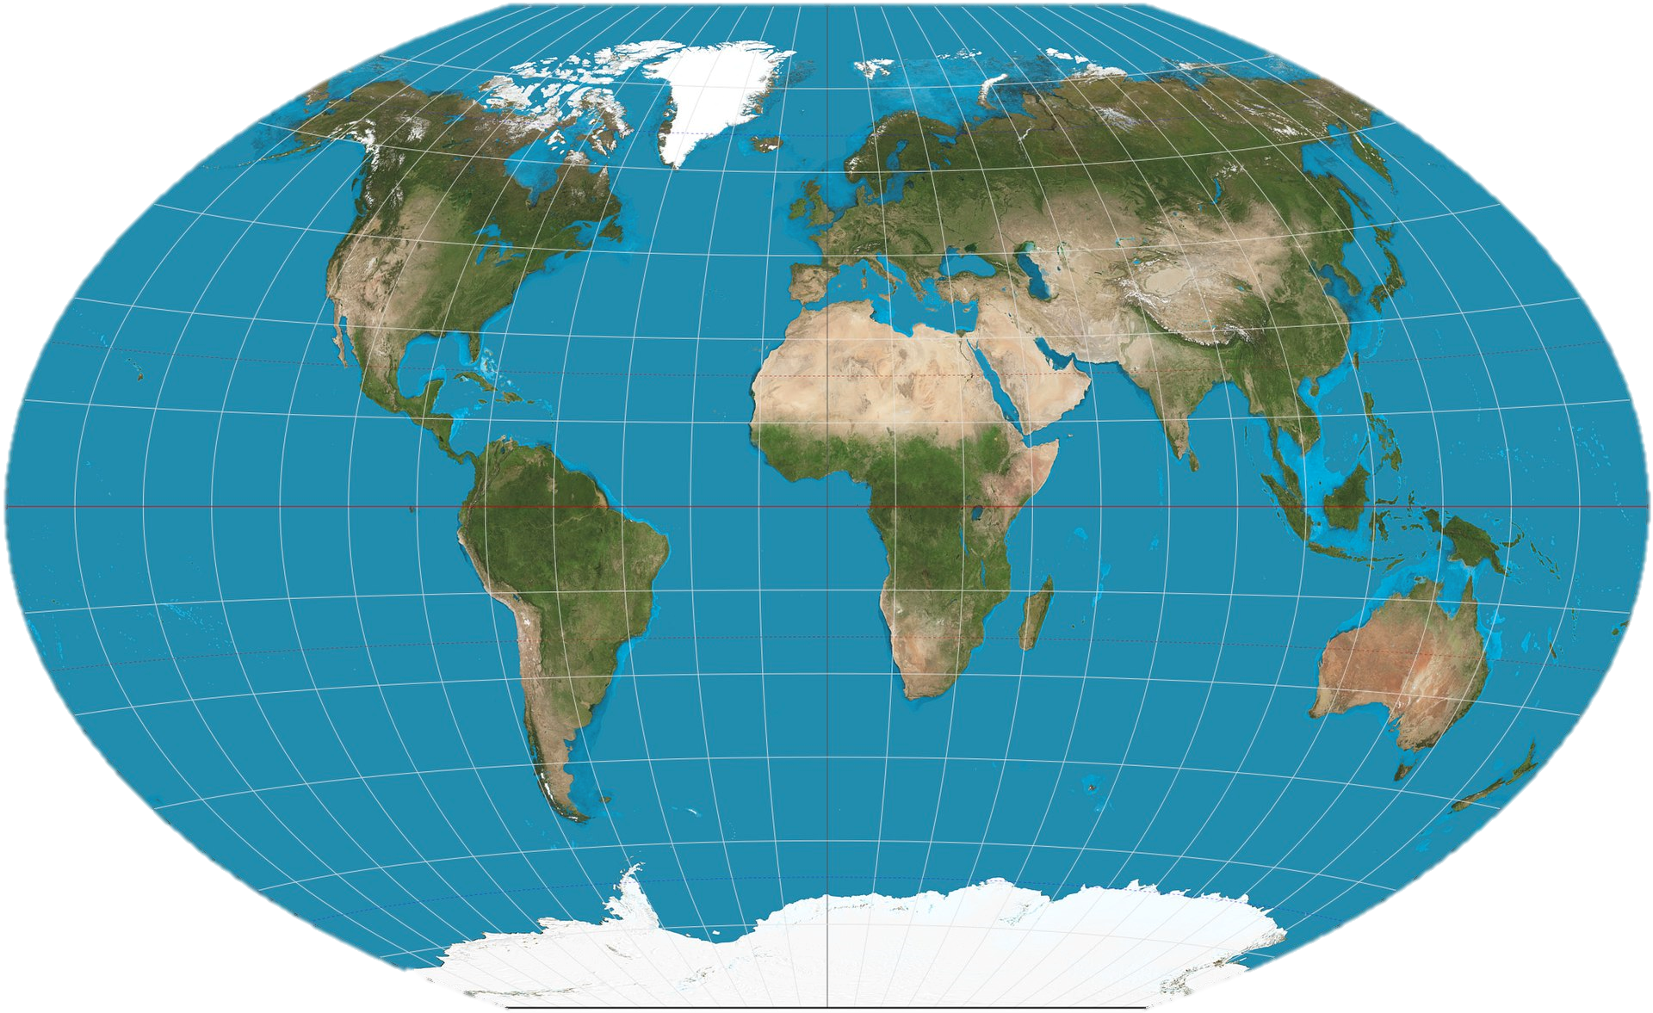
Focus is on the northwest Atlantic
Informing FM

Slide 18
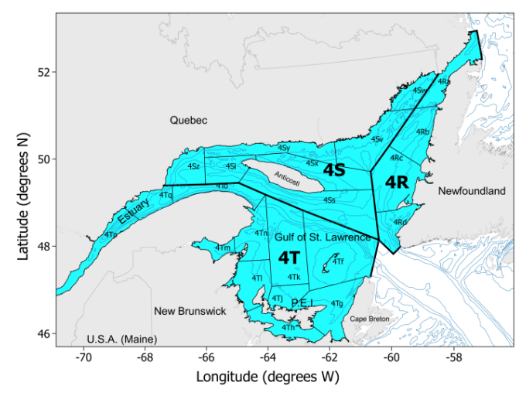
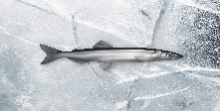
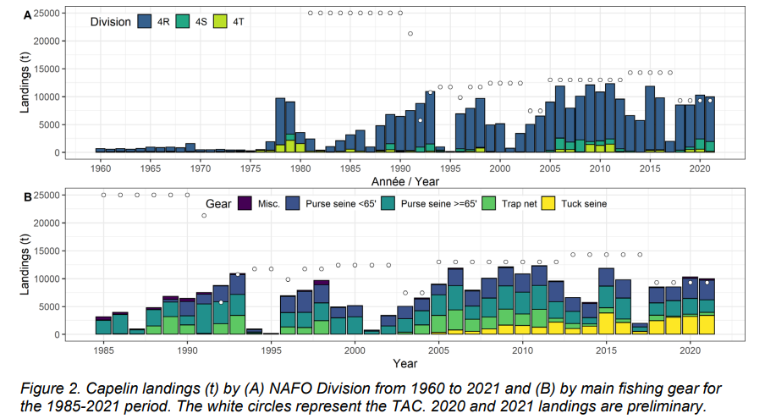
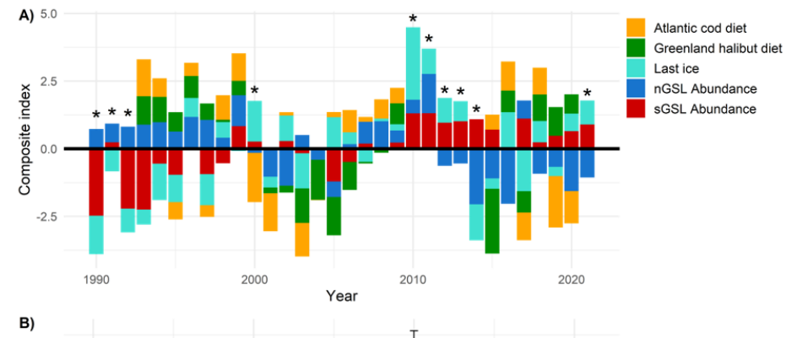
Status of a stock
Informing FM
Ref [14]
Notes:
Boudreau, M., Chamberland, J.-M., Girard, L., Boudreau, M., Benoît, H., Lehoux, C., Smith, A., Galbraith, P., and Plourde, S. 2021. Capelin in the Estuary and Gulf of St. Lawrence (NAFO Divs. 4RST) in 2021. Canadian Science Advisory Secretariat (CSAS).
Capelin in 4RST
Composite Index
Capelin as weight mass of prey
Atlantic cod
Greenland halibut
Increase of capelin in stomachs indicative of increase in capelin abundance and thus availability
Standardized using the total average, increase or decrease indicative of how the stock is doing

Slide 19
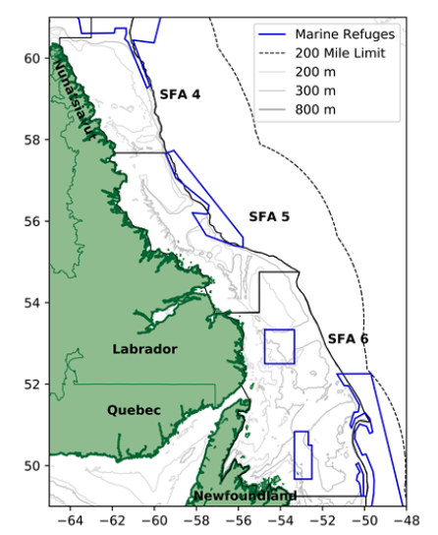


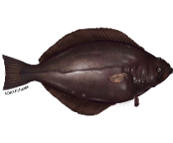
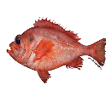
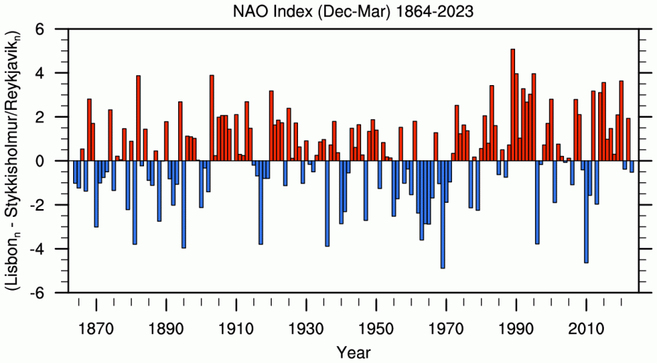
Forecasting productivity
This Year
Next Year
=
Shrimp density
+
Cod density
+
Other predator density
+
North Atlantic
Oscillation index
Informing FM
Ref [15]
Notes:
Pedersen, D., Skanes, W., le Corre, K., Koen Alonso, G., and Fiander, D. 2022. A New Spatial Ecosystem-Based Surplus Production Model for Northern Shrimp in Shrimp Fishing Areas 4 to 6. Canadian Science Advisory Secretariat= Secrétariat canadien de consultation ….
Billed https://www.joelsartore.com/ani026-00100/

Slide 20
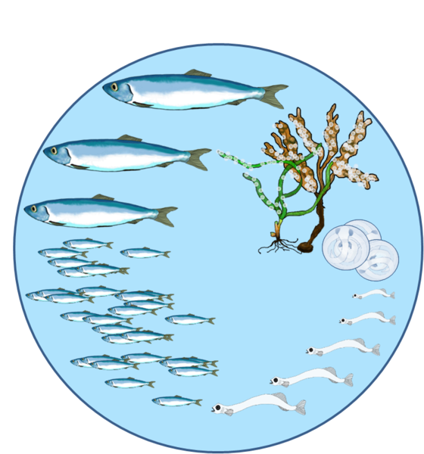
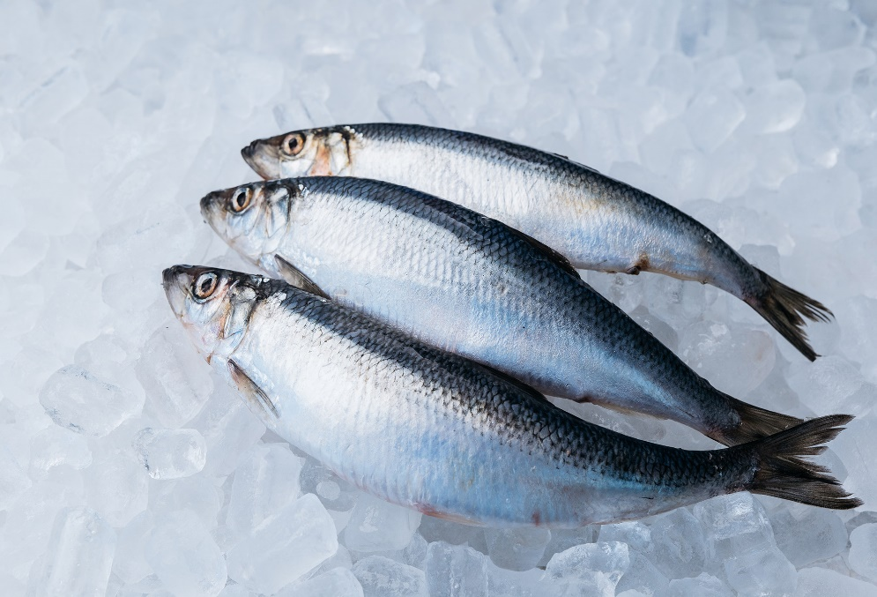
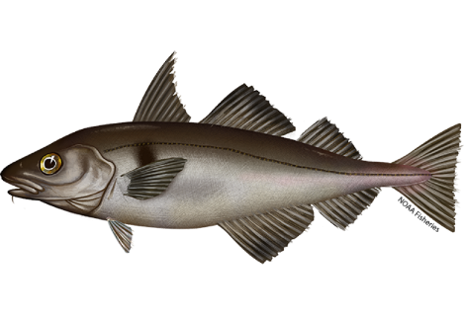
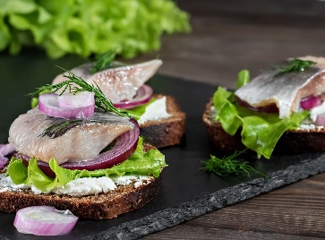
Early life stage
Thanks to NOAA Stomach
Sampling Programs and
NOAA Technical Reports
Informing FM
Ref [16]
Notes:
Langton RW, Bowman RE (1980) Food of ﬁfteen northwest Atlantic gadiform ﬁshes.NOAA Technical Report SSRF-740.

Slide 21
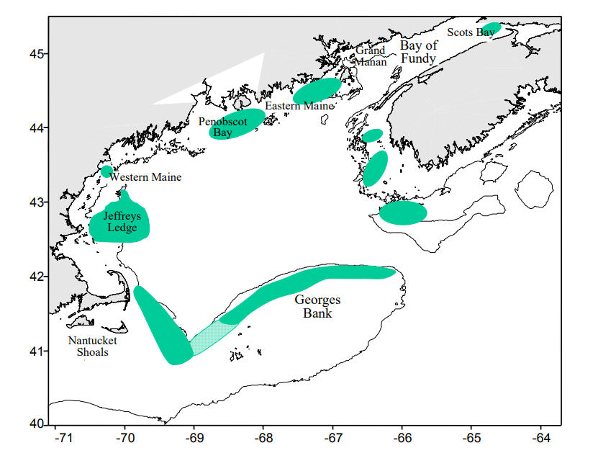
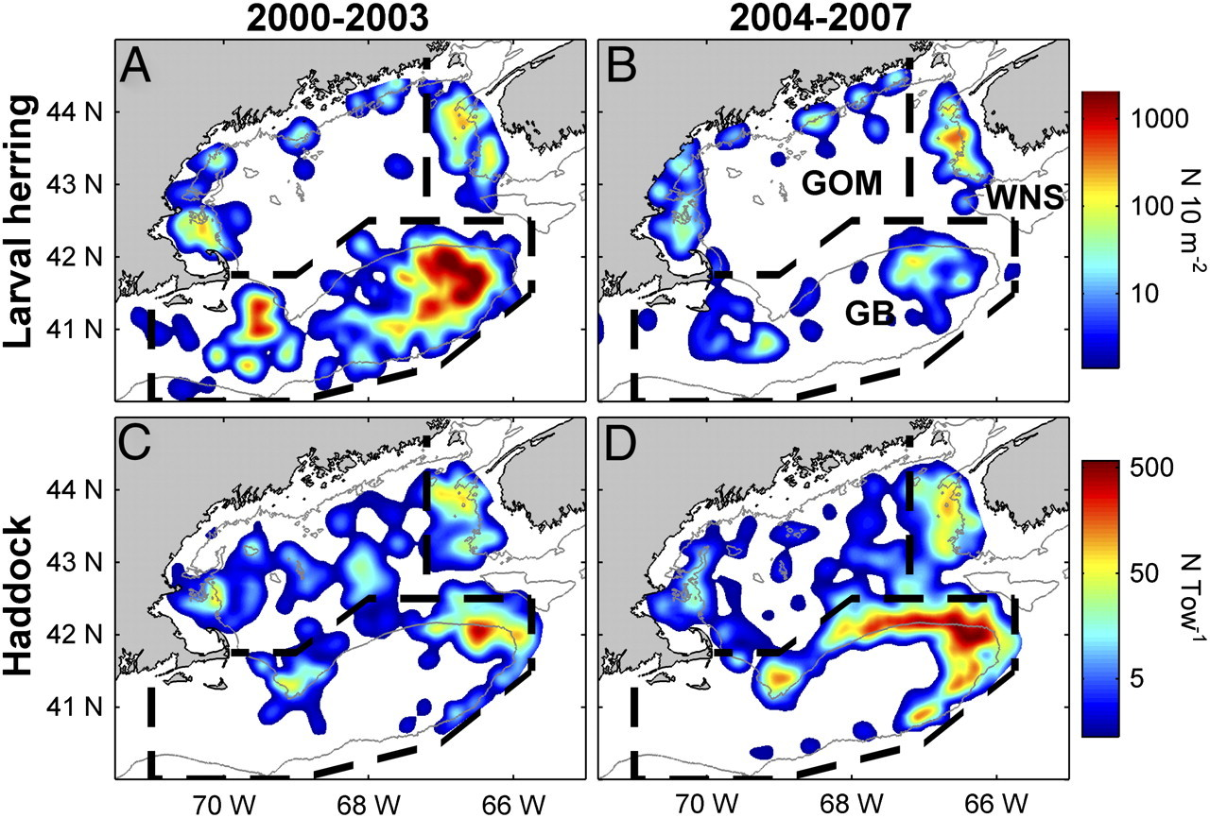
Early life stage
Informing FM
Ref [17]
Notes:
Richardson, D.E., Hare, J.A., Fogarty, M.J., and Link, J.S. 2011. Role of egg predation by haddock in the decline of an Atlantic herring population. Proceedings of the National Academy of Sciences 108(33): 13606–13611. National Acad Sciences.

Slide 22
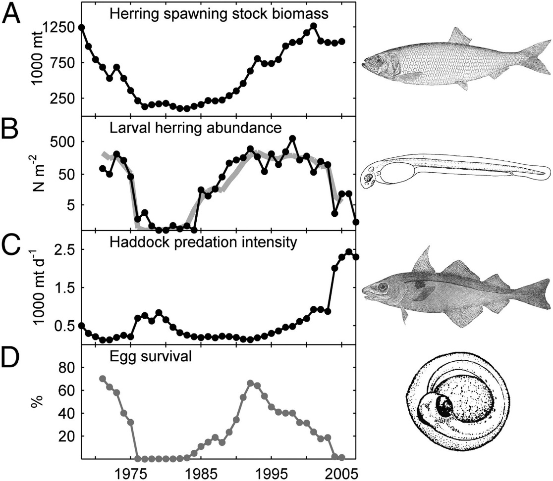
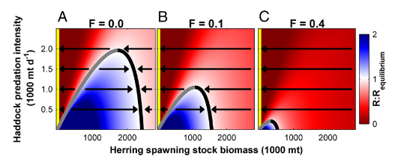
Early life stage
Richardson et al. 2011 showed how herring can handle higher predation by haddock through saturation, when in an upper stable equilibrium state (Black).
However, fishing intensity decreases the SSB and the population can’t saturate higher haddock predation meaning it becomes susceptible to depensation.
Ref [18]
Notes:
Richardson 2011

Slide 23
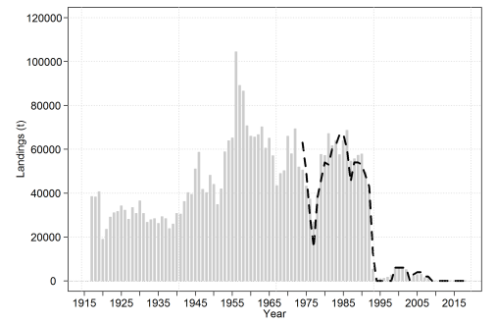
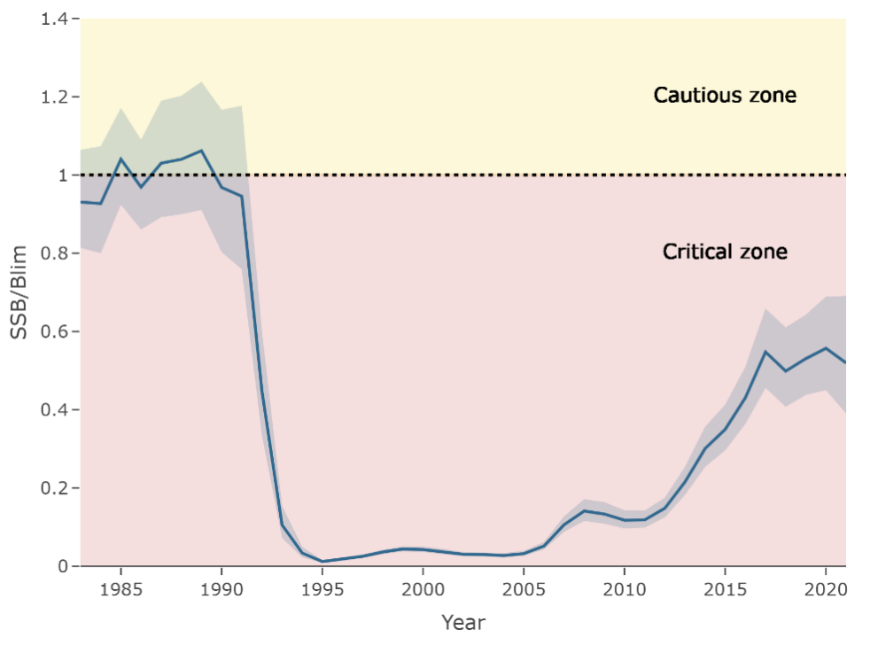
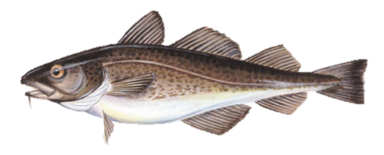
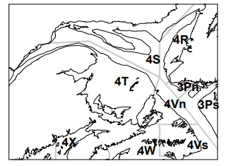



The question of stock rebuilding
Informing FM
Ref [19, 20]
Notes:
DFO. 2019. Assessment of Atlantic Cod (Gadus morhua) in the southern Gulf of St. Lawrence (NAFO Div. 4T-4Vn (Nov. – April)) to 2018. Canadian Science Advisory Secretariat (CSAS).
Neuenhoff, R.D., Swain, D.P., Cox, S.P., McAllister, M.K., Trites, A.W., Walters, C.J., and Hammill, M.O. 2019. Continued decline of a collapsed population of Atlantic cod (Gadus morhua) due to predation-driven Allee effects. Canadian Journal of Fisheries and Aquatic Sciences 76(1): 168–184. NRC Research Press.

Slide 24








2007
Hammill et al found little change in diet contribution from cod to grey seal through the 90’s
2010
Male seals of Gulf origin prey on winter aggregations of cod.
2022
Rossi estimate that serious culling
of grey seals was necessary but could
collapse the seal population
Early 1990’s Cod
stock collapses.
1994-1997, 2003 2009
Moratorium on
the sGSL cod stock
2009
Moratorium on
the sGSL cod stock
1990
2023
Grey Seal population increase.
2019
Results from Neuenhoff et al, found that sGSL cod stock lack of recover appears to be due to a predator driven Allee effect.
2006
Trzcinski et al, grey seals contribute significantly to the natural mortality of cod on the eastern Scotian shelf.
2006
Benoit et al, predaton by grey seals could explain 20% to 50% of natural mortality for cod in the southern part of the Gulf of St. Lawrence.
Informing FM
Notes:
file:///C:/Users/sebas/Downloads/aysaekanger,+NSP06_ch11.pdf
https://summit.sfu.ca/_flysystem/fedora/2023-01/etd22243.pdf

Slide 25


The question of stock rebuilding
Compensatory effect, is defined as increase in per capita recruitment with decreasing population.
Density-dependence, is defined as decreasing per capita recruitment with increasing population.
Depensation or “Allee effect”, is defined as decreasing per capita recruitment with decreasing population.
Predator pit is when mortality due to predation on a prey is higher than can be compensated for by the production rate.
Leaving the pit means breaking through the critical intersection as production rate is higher than mortality.
Or predator switches to more abundance prey, decreasing mortality.
Informing FM
Ref [21, 22]
Notes:
Wasp-waist populations and marine ecosystem dynamics: Navigating the “predator pit” topographies
Marine Ecology Progress Series 519:165 (int-res.com)
Neuenhoff, R.D., Swain, D.P., Cox, S.P., McAllister, M.K., Trites, A.W., Walters, C.J., and Hammill, M.O. 2019. Continued decline of a collapsed population of Atlantic cod (Gadus morhua) due to predation-driven Allee effects. Canadian Journal of Fisheries and Aquatic Sciences 76(1): 168–184. NRC Research Press.
Bakun, A., 2006. Wasp-waist populations and marine ecosystem dynamics: navigating the “predator pit” topographies. Progress in oceanography, 68(2-4), pp.271-288.

Slide 26








2007
Sherwood et al argued the need for capelin for a better cod stock.
2014
Buren et al determines that top-down predation from Harp Seals are not a driving factor
2022
Regular et al
Starvation index
for natural mortality
2015
Rose and Rowe saw cod biomass increase in parallel to increase in capelin biomass
Early 1990’s Cod
stock collapses
1992
Moratorium on
The Northern cod stock
1990
2023
Early 1990’s Capelin stock collapses
2002
Rose and O’Driscoll found links between capelin availability and cod diet, growth, condition, and reproductive potential.
2019
Koen-Alonso et al used a
bioenergetic-allometric model
showing how cod reliance
on capelin
2014
Mullowney and Rose find suboptimal diet is reason for low growth, poor condition and high mortality for cod, rather than temperature
Informing FM
Notes:
Add animation over time

Slide 27


The question of stock rebuilding
Koen-Alonso et al. 2019
Compared ecosystems (Newfoundland Shelf and Barents Sea).
Capelin required for cod increase.
Regular et al. 2022
High mortality of older cod due to starvation.
2J3KL (Northern) Cod
Capelin-informed mortality rates in the assessment model.
2J3KL Capelin
“The Capelin-Cod (Capcod) model was used to calculate a LRP of 640 kt of Capelin in the acoustic biomass index, below which the Capelin stock and the finfish community as a whole are likely at risk of serious harm.”
Informing FM
Ref [23, 24]
Notes:
Koen-Alonso, M., Lindstrøm, U., and Cuff, A. 2021. Comparative modeling of cod-capelin dynamics in the Newfoundland-Labrador shelves and Barents Sea ecosystems. Frontiers in Marine Science 8: 579946. Frontiers Media SA.
Regular, P.M., Buren, A.D., Dwyer, K.S., Cadigan, N.G., Gregory, R.S., Koen-Alonso, M., Rideout, R.M., Robertson, G.J., Robertson, M.D., Stenson, G.B., and others. 2022. Indexing starvation mortality to assess its role in the population regulation of Northern cod. Fisheries Research 247: 106180. Elsevier

Slide 28

Inclusion in Canadian NW Atlantic?
Latest stock assessments from CSAS - Science Advisory Report (2005+) using Pepin 2019^{[25]} paper as a template.
Keyword searching for “predator“, “prey“ and “consumed”.
 | Numbers of Assessments
Total | 77
Mentioned | 42 (54%)
Descriptive | 32 (41%)
Quantitative | 10 (13%)
Discussion

Slide 29








Why not always?
“Including drivers may only be successful if there is a good understanding of how ecosystem processes affect stock production.” Skern-Mauritzen et al. 2016
What drives population fluctuations?
Degree and which interaction can vary.
Discussion
Ref [26, 27, 28]
Notes:
Ecosystem processes are rarely included in tactical fisheries management – Skern-Mauritzen
Émond, K., Sainte-Marie, B., Galbraith, P.S., and Bêty, J. 2015. Top-down vs. bottom-up drivers of recruitment in a key marine invertebrate: investigating early life stages of snow crab. ICES Journal of Marine Science 72(5): 1336–1348. doi:10.1093/icesjms/fsu240.

Slide 30

Concluding Remarks
SCA mtDNA FA BSIA AA-CSIA
Detailed taxonomic resolution of the diet
Individual preys' life stage and size.
Capture diet on a temporal scale.
Quantification of prey
Trophic Position
Notes:
Going back to the question, and answering it.
Briefly describe the key empirical approaches to understand trophic interactions and how they can be extrapolated to ecosystem scales.
What are the limitations and knowledge gaps of these approaches that prevent the inclusion of trophic interactions in stock assessment processes, and how could they be overcome?”

Slide 31
Concluding Remarks
We have seen…
However…
Trophic interactions can help inform different aspects of a stock.
Such as stock status, future productivity, recruitment and impaired recovery.
Inclusion in stocks assessments and hence inform fisheries management depends on foundational research to elucidate mechanisms.
Notes:
Going back to the question, and answering it.
Briefly describe the key empirical approaches to understand trophic interactions and how they can be extrapolated to ecosystem scales.
What are the limitations and knowledge gaps of these approaches that prevent the inclusion of trophic interactions in stock assessment processes, and how could they be overcome?”

Slide 32
Thank you

Slide 33
References
https://www.wildanimalinitiative.org/blog/trophicinteractions#:~:text=The%20transfer%20of%20energy%20from,more%20colloquially%2C%20a%20food%20chain [1]
Hanley, T.C. and La Pierre, K.J. eds., 2015. Trophic ecology. Cambridge University Press.[2]
Sánchez‐Hernández, J., Nunn, A.D., Adams, C.E. and Amundsen, P.A., 2019. Causes and consequences of ontogenetic dietary shifts: a global synthesis using fish models. Biological Reviews, 94(2), pp.539-554. [3]
Nielsen, J.M., Clare, E.L., Hayden, B., Brett, M.T. and Kratina, P., 2018. Diet tracing in ecology: Method comparison and selection. Methods in Ecology and Evolution, 9(2), pp.278-291.[4]
Hyslop, E.J., 1980. Stomach contents analysis—a review of methods and their application. Journal of fish biology, 17(4), pp.411-429.[5]
de Sousa, L.L., Silva, S.M. and Xavier, R., 2019. DNA metabarcoding in diet studies: Unveiling ecological aspects in aquatic and terrestrial ecosystems. Environmental DNA, 1(3), pp.199-214.[6]
Jakubavičiūtė, E., Bergström, U., Eklöf, J.S., Haenel, Q. and Bourlat, S.J., 2017. DNA metabarcoding reveals diverse diet of the three-spined stickleback in a coastal ecosystem. PLoS One, 12(10), p.e0186929.[7]
Fry, B., 2006. Stable isotope ecology (Vol. 521, p. 318). New York: Springer.[8]
Galloway, A.W. and Budge, S.M., 2020. The critical importance of experimentation in biomarker-based trophic ecology. Philosophical Transactions of the Royal Society B, 375(1804), p.20190638. [9]
Whiteman, J.P., Elliott Smith, E.A., Besser, A.C. and Newsome, S.D., 2019. A guide to using compound-specific stable isotope analysis to study the fates of molecules in organisms and ecosystems. Diversity, 11(1), p.8. [10, 11]
Bowes, R.E. and Thorp, J.H., 2015. Consequences of employing amino acid vs. bulk‐tissue, stable isotope analysis: A laboratory trophic position experiment. Ecosphere, 6(1), pp.1-12. [12]
Boudreau, M., Chamberland, J.-M., Girard, L., Boudreau, M., Benoît, H., Lehoux, C., Smith, A., Galbraith, P., and Plourde, S. 2021. Capelin in the Estuary and Gulf of St. Lawrence (NAFO Divs. 4RST) in 2021. Canadian Science Advisory Secretariat (CSAS). [14]
Pedersen, D., Skanes, W., le Corre, K., Koen Alonso, G., and Fiander, D. 2022. A New Spatial Ecosystem-Based Surplus Production Model for Northern Shrimp in Shrimp Fishing Areas 4 to 6. Canadian Science Advisory Secretariat= Secrétariat canadien de consultation …. [15]
Langton RW, Bowman RE (1980) Food of ﬁfteen northwest Atlantic gadiform ﬁshes.NOAA Technical Report SSRF-740. [16]
Richardson, D.E., Hare, J.A., Fogarty, M.J., and Link, J.S. 2011. Role of egg predation by haddock in the decline of an Atlantic herring population. Proceedings of the National Academy of Sciences 108(33): 13606–13611. National Acad Sciences. [17, 18]
DFO. 2019. Assessment of Atlantic Cod (Gadus morhua) in the southern Gulf of St. Lawrence (NAFO Div. 4T-4Vn (Nov. – April)) to 2018. Canadian Science Advisory Secretariat (CSAS). [19]
DFO. 202024. Northern (2J3KL) Atlantic Cod Assessment Framework. Canadian Science Advisory Secretariat (CSAS). [20]
Neuenhoff, R.D., Swain, D.P., Cox, S.P., McAllister, M.K., Trites, A.W., Walters, C.J., and Hammill, M.O. 2019. Continued decline of a collapsed population of Atlantic cod (Gadus morhua) due to predation-driven Allee effects. Canadian Journal of Fisheries and Aquatic Sciences 76(1): 168–184. NRC Research Press. [21]
Bakun, A., 2006. Wasp-waist populations and marine ecosystem dynamics: navigating the “predator pit” topographies. Progress in oceanography, 68(2-4), pp.271-288. [22]
Koen-Alonso, M., Lindstrøm, U., and Cuff, A. 2021. Comparative modeling of cod-capelin dynamics in the Newfoundland-Labrador shelves and Barents Sea ecosystems. Frontiers in Marine Science 8: 579946. Frontiers Media SA. [23]
Regular, P.M., Buren, A.D., Dwyer, K.S., Cadigan, N.G., Gregory, R.S., Koen-Alonso, M., Rideout, R.M., Robertson, G.J., Robertson, M.D., Stenson, G.B., and others. 2022. Indexing starvation mortality to assess its role in the population regulation of Northern cod. Fisheries Research 247: 106180. Elsevier [24]
Pepin, P., King, J., Holt, C., Gurney‐Smith, H., Shackell, N., Hedges, K. and Bundy, A., 2022. Incorporating knowledge of changes in climatic, oceanographic and ecological conditions in Canadian stock assessments. Fish and Fisheries, 23(6), pp.1332-1346. [25]
Skern‐Mauritzen, M., Ottersen, G., Handegard, N.O., Huse, G., Dingsør, G.E., Stenseth, N.C. and Kjesbu, O.S., 2016. Ecosystem processes are rarely included in tactical fisheries management. Fish and Fisheries, 17(1), pp.165-175. [26]
Émond, K., Sainte-Marie, B., Galbraith, P.S., and Bêty, J. 2015. Top-down vs. bottom-up drivers of recruitment in a key marine invertebrate: investigating early life stages of snow crab. ICES Journal of Marine Science 72(5): 1336–1348. doi:10.1093/icesjms/fsu240. [27]
Marcello, L.A., Mueter, F.J., Dawe, E.G. and Moriyasu, M., 2012. Effects of temperature and gadid predation on snow crab recruitment: comparisons between the Bering Sea and Atlantic Canada. Marine Ecology Progress Series, 469, pp.249-261. [28]
NEFSC, 2018. 65th Northeast Regional Stock Assessment Workshop (65th SAW) Assessment Report. [29]
Pepin, P., Koen-Alonso, M., Boudreau, S.A., Cogliati, K.M., den Heyer, C.E., Edwards, A.M., Hedges, K.J. and Plourde, S., 2023. Fisheries and Oceans Canada's Ecosystem Approach to Fisheries Management Working Group: case study synthesis and lessons learned. Fisheries and Oceans Canada, Northwest Atlantic Fisheries Centre. [30]

Slide 34
Picture References
https://www.aqua.dtu.dk/-/media/institutter/aqua/publikationer/forskningsrapporter_301_351/338-2019-essential-fish-habitats.pdf [1P]
https://h5p.org/h5p/embed/477535 [2P]
https://www.fisheries.noaa.gov/species/atlantic-herring [3P]
https://www.fisheries.noaa.gov/species/harp-seal [3P]
https://www.fisheries.noaa.gov/species/atlantic-halibut [3P]
Wheater, C.P., Bell, J.R. and Cook, P.A., 2020. Practical field ecology: a project guide. John Wiley & Sons.[4P]
https://www.amnh.org/explore/ology/ology-cards/193-phytoplankton [5P]
https://www.sciencedirect.com/science/article/abs/pii/S0048969720330011 [5P]
Harada, Y., Ito, S.I., Ogawa, N.O., Yoshikawa, C., Ishikawa, N.F., Yoneda, M. and Ohkouchi, N., 2022. Compound-specific nitrogen isotope analysis of amino acids in eye lenses as a new tool to reconstruct the geographic and trophic histories of fish. Frontiers in Marine Science, 8, p.796532. [6P]
https://oceanservice.noaa.gov/education/marine-ecosystem-modeling-vr/ocean-food-webs/activity-4.html [7P]
https://www.fisheries.noaa.gov/feature-story/noaa-fisheries-leading-united-nations-advancing-ecosystem-approaches-fisheries [8P]
https://en.wikipedia.org/wiki/World_map [9P]
Pint, S., De Troch, M., van Oevelen, D., Heymans, J.J. and Everaert, G., 2021. Ecopath model of the southern North Sea. Techn. Rep.[10P]

Slide 35


Sometimes, something goes wrong…
Ecosystem variables are included ad hoc, with little standardized framework.
Comprehensive foundational information is necessary for the implementation of even a modest ecosystem approach.
Considerable effort is required from scientists before FM is able to consider ecosystem variables.
Assessment of Atlantic Herring in Gulf of Maine
Age Structured Assessment Program, but a retrospective pattern was occurring.
2012 - Consumption estimates provided argument for time varying mortality.
2015 - A retrospective pattern emerged.
Setting mortality to 0.35
Discussion
Ref [29, 30]
Notes:
Retrospective patterns are systematic changes in estimates of population size, or other assessment model-derived quantities, that occur as additional years of data are added to, or removed from, a stock assessment.
The retrospective problem is said to exist when the various estimates for a given year do not agree and the disagreement is a systematic pattern of biases rather than a random scattering
@article{hurtado2015looking, title={Looking in the rear-view mirror: bias and retrospective patterns in integrated, age-structured stock assessment models}, author={Hurtado-Ferro, Felipe and Szuwalski, Cody S and Valero, Juan L and Anderson, Sean C and Cunningham, Curry J and Johnson, Kelli F and Licandeo, Roberto and McGilliard, Carey R and Monnahan, Cole C and Muradian, Melissa L and others}, journal={ICES Journal of Marine Science}, volume={72}, number={1}, pages={99--110}, year={2015}, publisher={ICES/CIEM} }
@book{pepin2023fisheries, title={Fisheries and Oceans Canada's Ecosystem Approach to Fisheries Management Working Group: case study synthesis and lessons learned}, author={Pepin, Pierre and Koen-Alonso, Mariano and Boudreau, Stephanie A and Cogliati, Karen M and den Heyer, Cornelia E and Edwards, Andrew M and Hedges, Kevin J and Plourde, St{\'e}phane}, year={2023}, publisher={Fisheries and Oceans Canada, Northwest Atlantic Fisheries Centre} }
NEFSC, 2018. 65th Northeast Regional Stock Assessment Workshop (65th SAW) Assessment Report.

Slide 36
Even so, Why not more readily included
Process
Coordination between scientists, resource managers, policy makers, economics is a necessity.
Degree of coordination varies greatly between regions.
Considerable effort is required from scientists before FM is able to consider it.
Science
Found ecosystem variables to be included ad hoc, with little standardized framework.
Comprehensive foundational information is necessary for the implementation of even a modest ecosystem approach.
Communication and engagement
Ecosystems are complex entities that can be difficult to understand for non-experts.
Clear links between stocks and EV can help facilitate the acceptance of such approaches.
Advice needs to be actionable
Discussion

Slide 37
Metabarcoding
High taxonomic resolution.
Does not provide prey life stage and size information.
Captures only a snapshot of life.
Absence/presence information.
Requires knowledge of prey trophic position.
Methods
de Sousa et al. 2019, Jakubavičiūtė et al. 2017
Notes:
de Sousa, L.L., Silva, S.M., and Xavier, R. 2019. DNA metabarcoding in diet studies: Unveiling ecological aspects in aquatic and terrestrial ecosystems. Environmental DNA 1(3): 199–214. Wiley Online Library.
Jakubavičiūtė, E., Bergström, U., Eklöf, J.S., Haenel, Q., and Bourlat, S.J. 2017. DNA metabarcoding reveals diverse diet of the three-spined stickleback in a coastal ecosystem. PLoS One 12(10): e0186929. Public Library of Science San Francisco, CA USA.

